Slide 1
Recommendation system for scientific tools and workflows
Master’s thesis
07/08/2018
Anup Kumar
Adviser: Dr. Björn Grüning

Slide 2
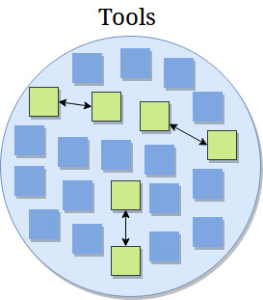
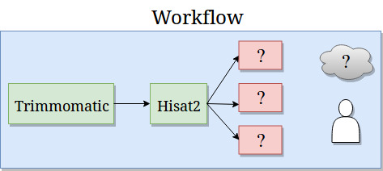
Motivation
Galaxy - biological data analysis
Tools and workflows
Large number of tools (> 1,000)
Complex workflows
Need guidance - recommendation system

Slide 3
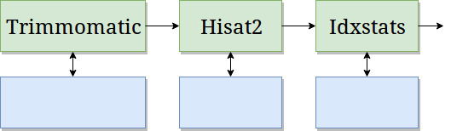
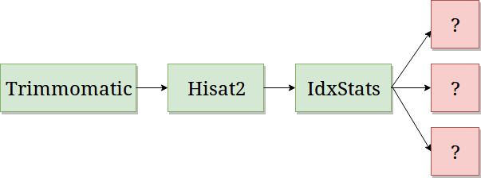
Recommendation system
Find similar scientific tools
2. Predict tools in workflows

Slide 4
Find similar scientific tools

Slide 5
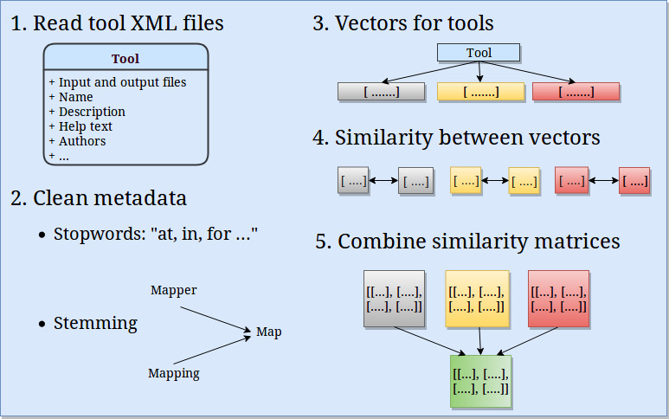

Slide 6
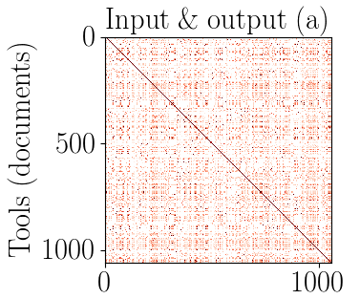

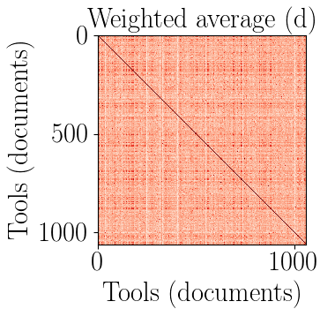
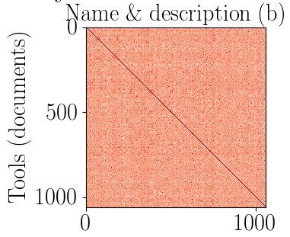
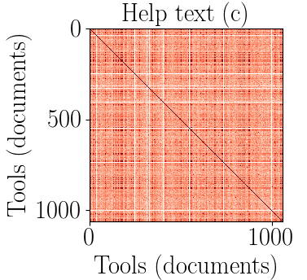
Combine similarity matrices

Slide 7
2. Predict tools in workflows

Slide 8
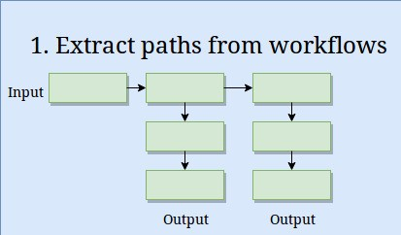
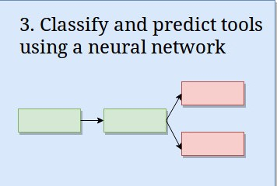
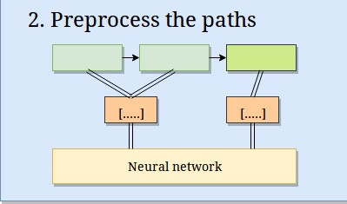
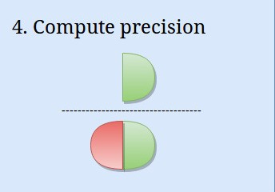
Approach

Slide 9
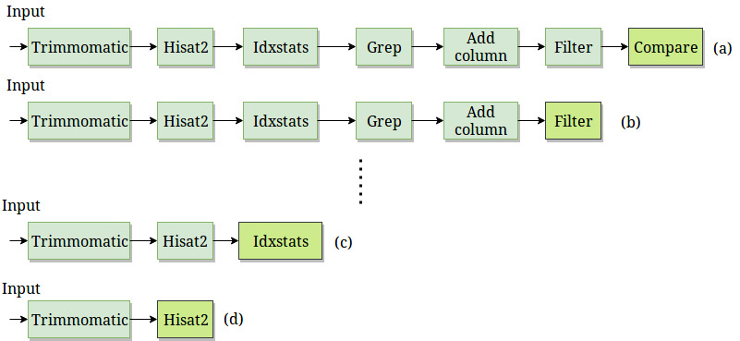
Path preprocessing

Slide 10
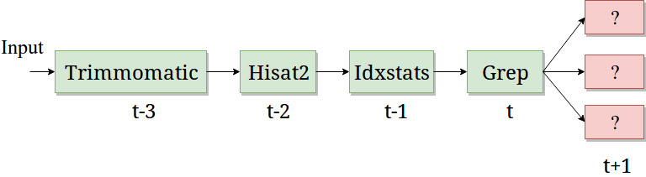
Recurrent neural network
Classifier to learn on sequential data
Recurrent neural network - Gated recurrent units
Recurrent neural network: https://arxiv.org/pdf/1412.3555.pdf
Gated recurrent units: https://arxiv.org/pdf/1412.3555v1.pdf

Slide 11
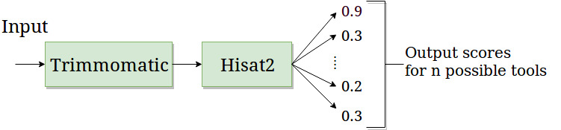
Prediction and precision
Score for each predicted tool
Absolute precision
Compatible precision

Slide 12
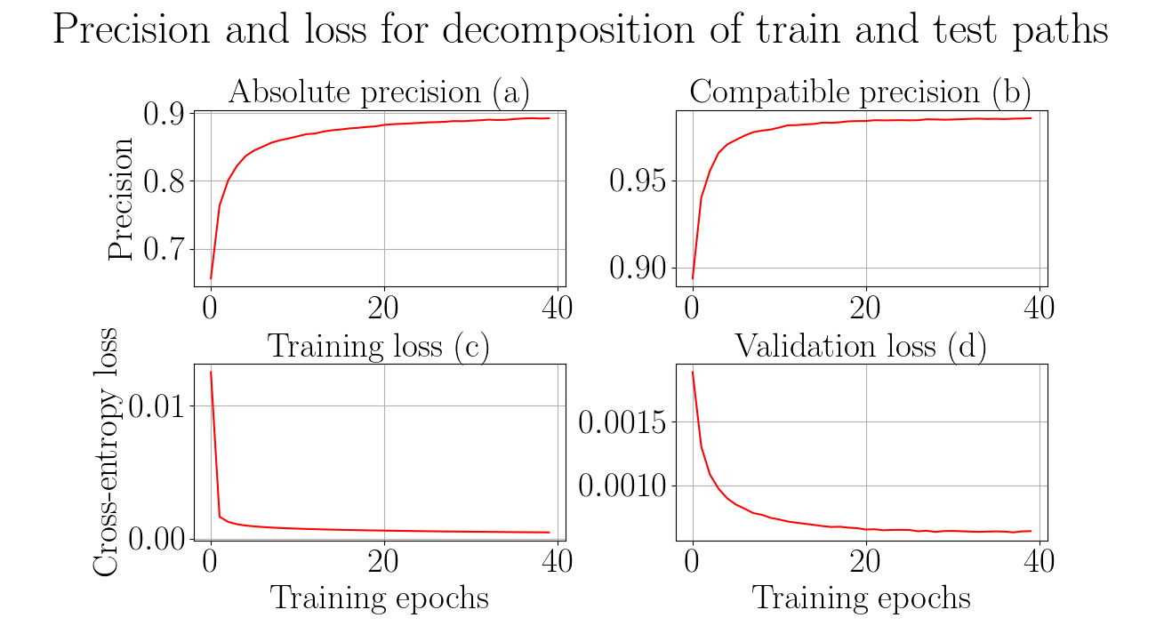

Slide 13


Slide 14
Conclusion and future work (part 1)
Collect and clean tools metadata (~ 1,050 tools)
Learn vectors for each tool
Compute and combine similarity matrices
Run analysis on larger set of tools
Compute similar tools using workflows

Slide 15
Summary and conclusion (part 2)
Workflows - directed acyclic graphs (193,000)
Paths (167,000 unique)
Recurrent neural network (gated recurrent units)
Absolute precision ~ 89%, compatible precision ~ 99% (~ 48 hrs)
More workflows, better precision
Recommendation system using similar and predicted tools

Slide 16
Future work (part 2)
Restore original distribution
Decay prediction over time
Integrate into Galaxy

Slide 17
Thank you all!
Prof. Dr. Rolf Backofen
Prof. Dr. Wolfgang Hess
Dr. Björn Grüning
Dr. Anika Erxleben
Helena Rasche
Nate Coraor (Galaxy team, Penn State University)
Freiburg Galaxy team and Bioinformatics Group Freiburg

Slide 18
Thank you for your attention
Questions?

Slide 19
Supplementary material

Slide 20
Stemming and stopwords
Stemming - converge all forms of a word into one basic form
“Operate, operating, operates, operation, operative, operatives, operational” into “oper” [1]
Stopwords - “a, about, above, would, could …” [2]
https://nlp.stanford.edu/IR-book/html/htmledition/stemming-and-lemmatization-1.html
https://www.ranks.nl/stopwords

Slide 21
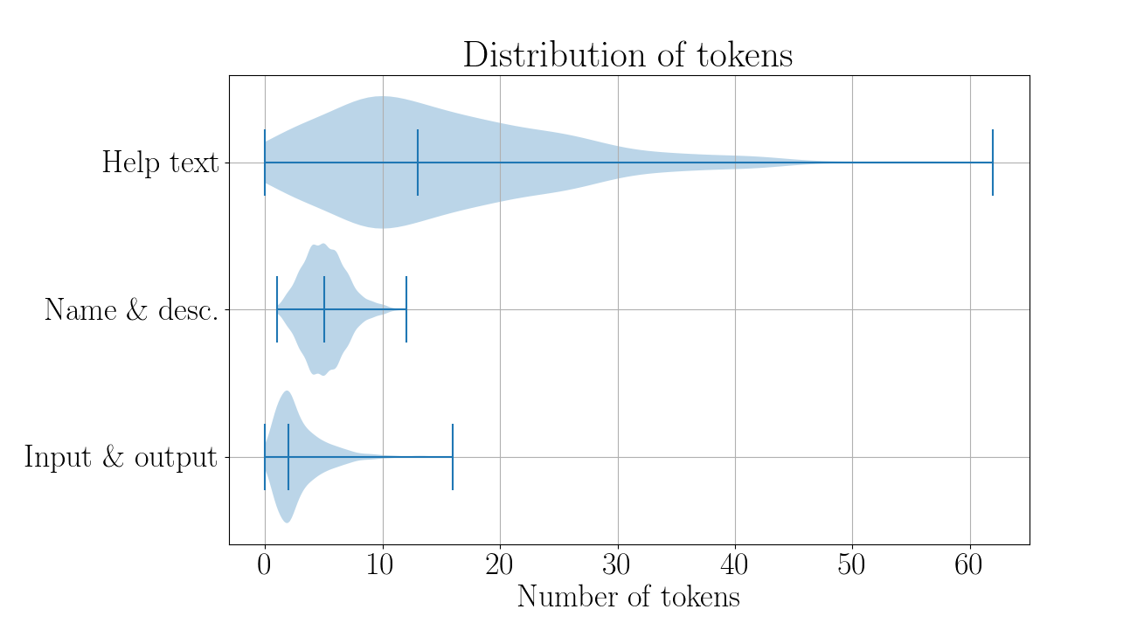

Slide 22
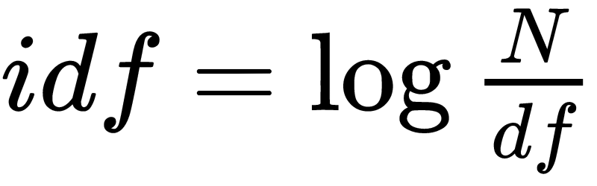
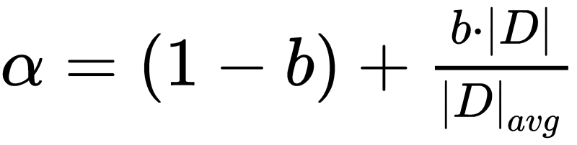
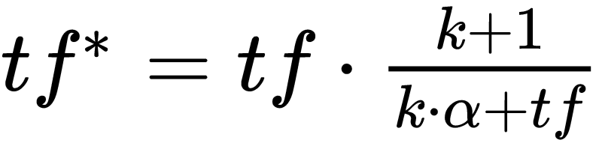
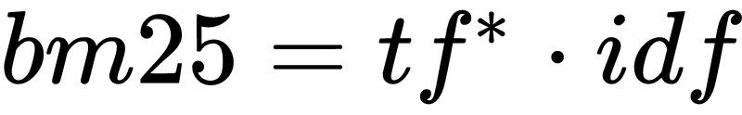
Bestmatch25 (bm25)
Token frequency (tf)
Document and inverted document frequency (idf)
https://dl.acm.org/citation.cfm?id=1704810
http://www.staff.city.ac.uk/~sb317/papers/foundations_bm25_review.pdf

Slide 23
Bestmatch25 (bm25) scores
Tools/Tokens | Regress | Linear | Gap | Mapper | Perform
LinearRegression | 5.22 | 4.1 | 0.0 | 0.0 | 3.84
LogisticRegression | 3.54 | 0.0 | 0.0 | 0.0 | 2.61
Tophat2 | 0.0 | 0.0 | 1.47 | 1.47 | 0.0
Hisat | 0.0 | 0.0 | 0.0 | 0.0 | 0.0

Slide 24

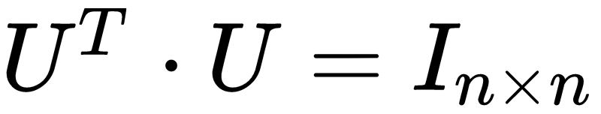
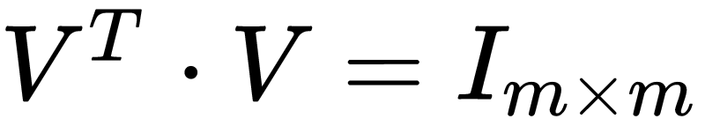
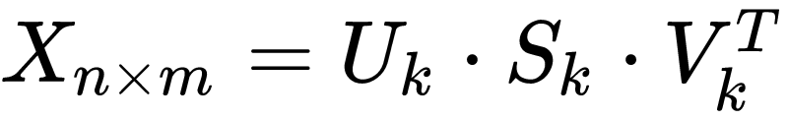
Latent Semantic Analysis
Document-token matrix (X)
Singular value decomposition
http://theory.stanford.edu/~tim/s15/l/l9.pdf

Slide 25
Paragraph (document) vector
A dense vector for each paragraph
Paragraph - a collection of tokens
Similar paragraphs, similar vectors
Encode variable length paragraphs
Each tool has three paragraphs (documents)
Paragraph vector: https://cs.stanford.edu/~quocle/paragraph_vector.pdf
Input/output file types - https://dl.acm.org/citation.cfm?id=1704810 (bestmatch25)

Slide 26

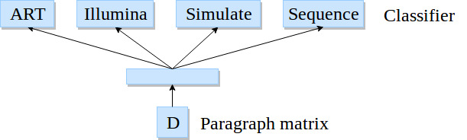
Paragraph vectors
Softmax classifier
Backpropagation
Stochastic gradient descent
Gensim*
800 iterations, 10 epochs
*https://radimrehurek.com/gensim/models/doc2vec.html
Image adapted from: https://cs.stanford.edu/~quocle/paragraph_vector.pdf

Slide 27
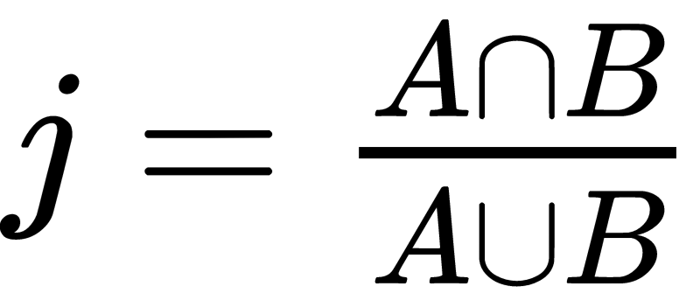
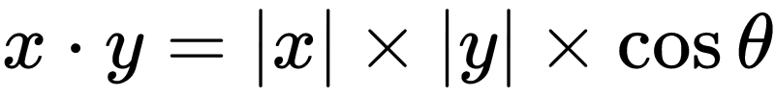
Similarity scores
Jaccard index (input and output file types)
Cosine angle (name and description and help text)
Compute similarity matrix
Three similarity matrices
Simple - average the matrices
Better - learn weights
Jaccard index: https://link.springer.com/article/10.1007/BF02365362
Cosine angle similarity: https://www.itl.nist.gov/div898/software/dataplot/refman2/auxillar/cosdist.htm

Slide 28
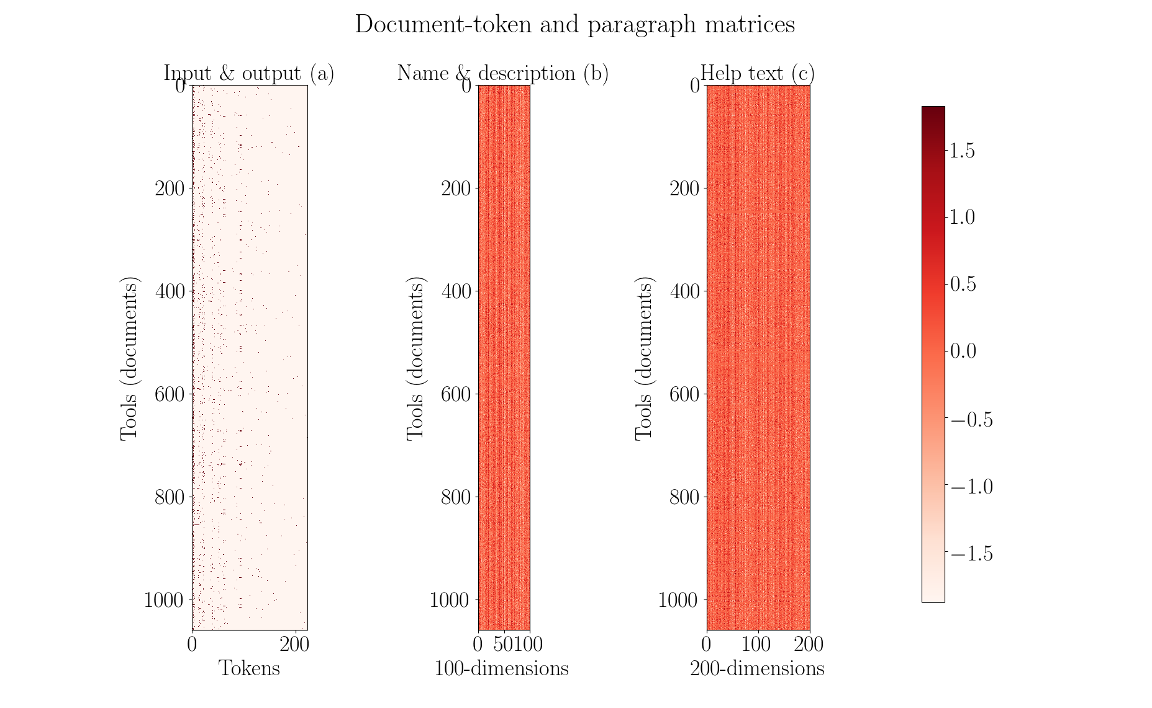

Slide 29
Optimisation
Gradient descent
Learn weights on similarity scores
Mean squared error
Each tool, 3 weights
Obtain a weighted average similarity matrix
True similarity is an array of 1.0
https://developers.google.com/machine-learning/crash-course/reducing-loss/gradient-descent

Slide 30

Optimisation
Gradient descent
Learn weights on similarity scores
Obtain a weighted average similarity matrix
…. (1)
…. (2)
…. (3)

Slide 31
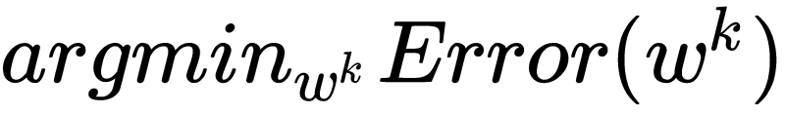
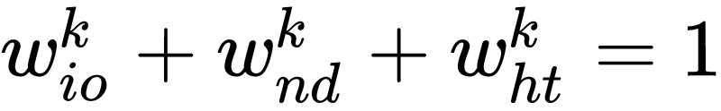
Optimisation

Slide 32
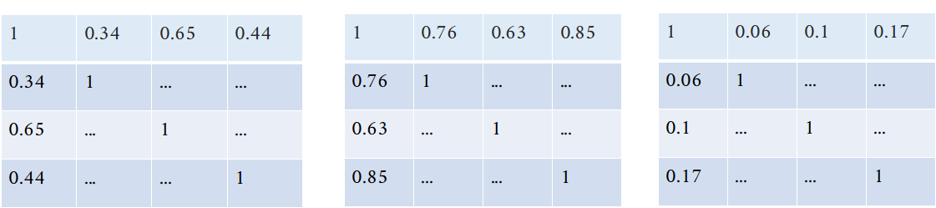
Optimisation

Slide 33

Optimisation
Initial learning rate - 0.05
Decay learning rate
Nesterov’s accelerated gradient
https://arxiv.org/pdf/1609.04747.pdf

Slide 34
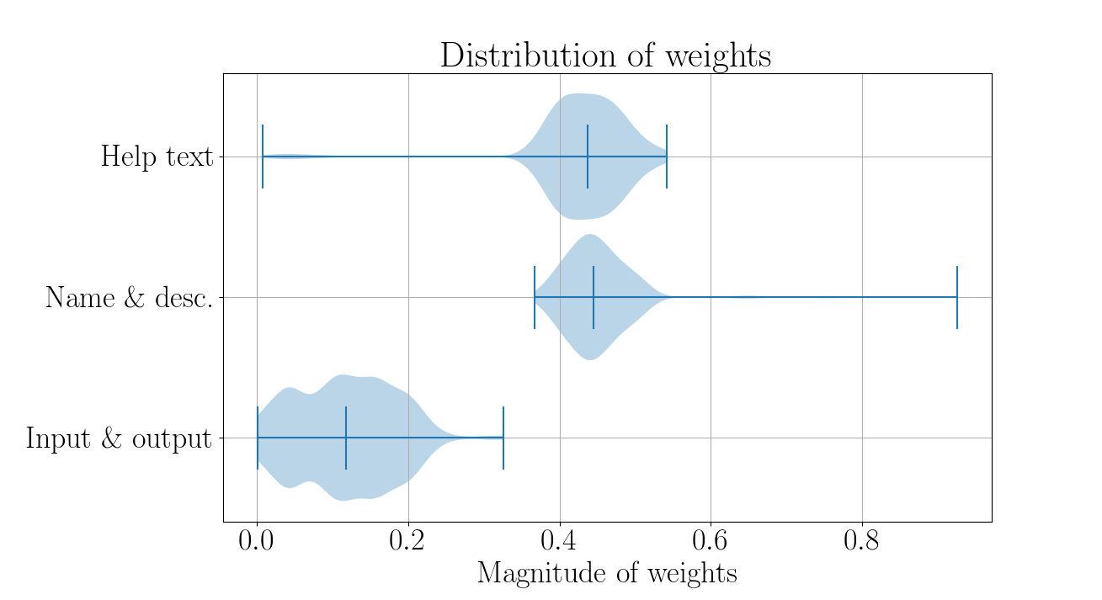

Slide 35
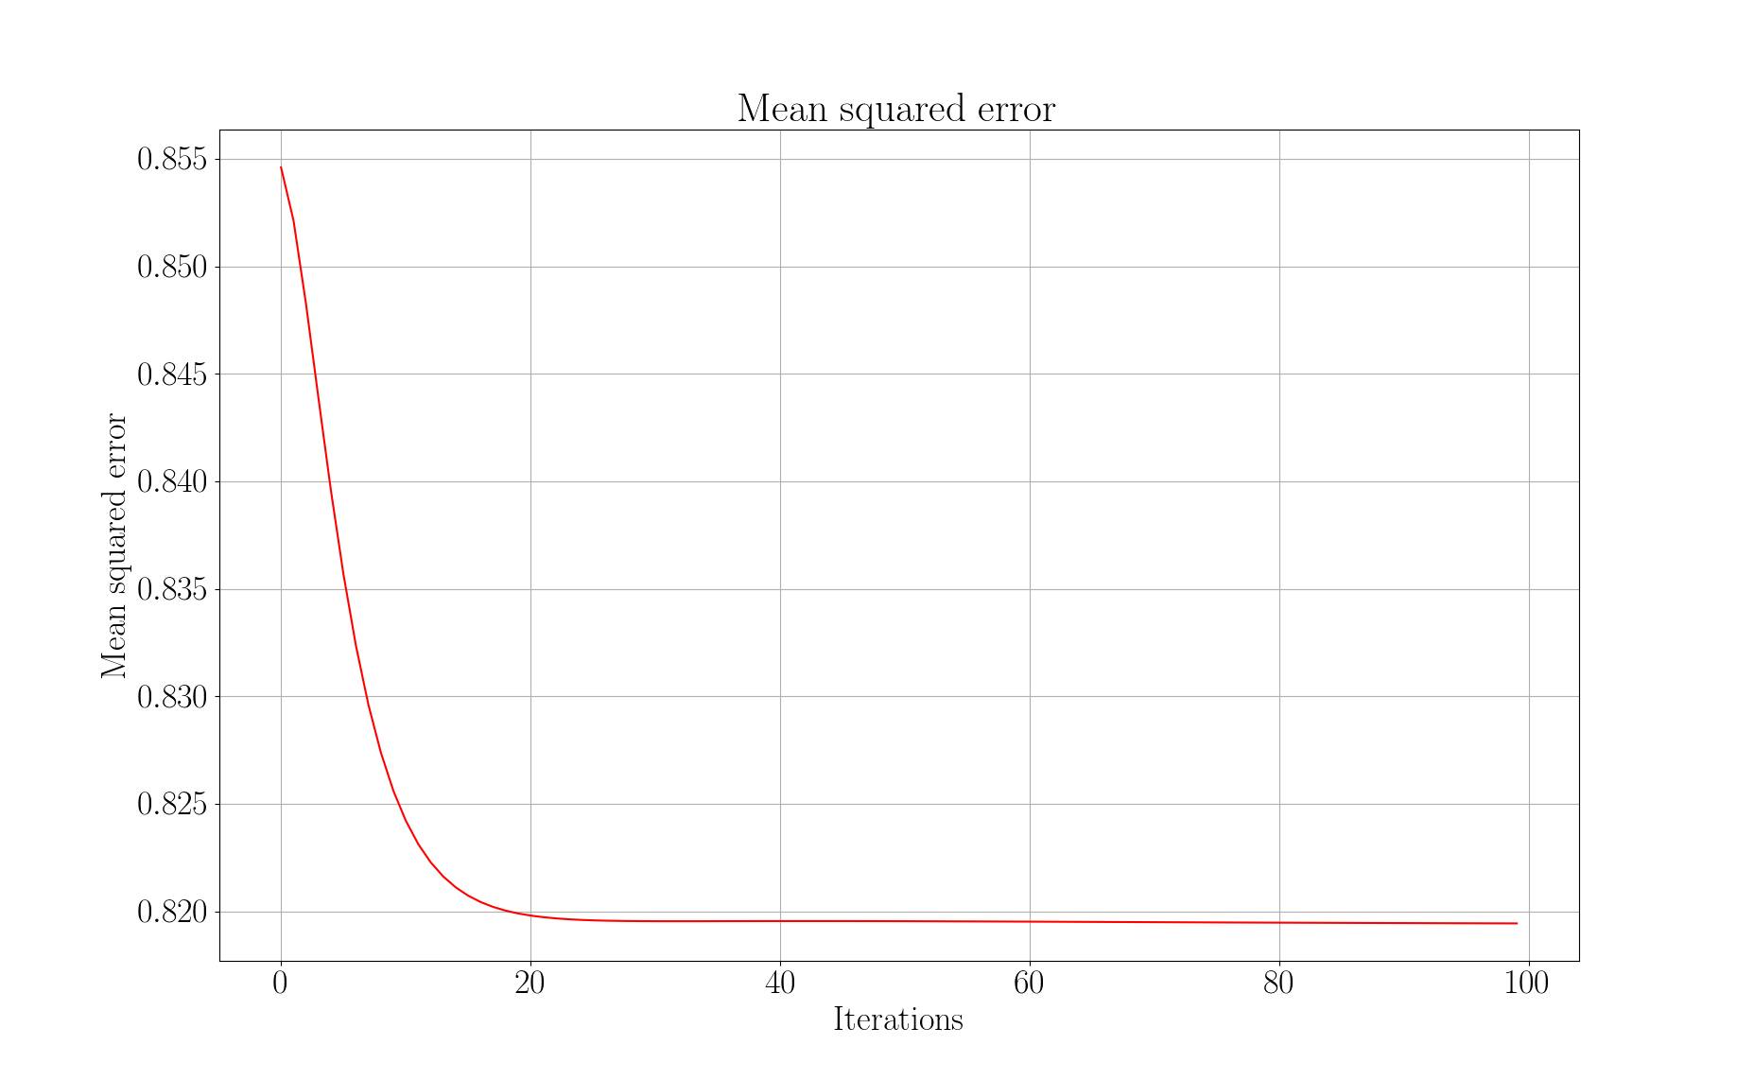

Slide 36
Visualisers
Paragraph vectors
Latent Semantic Analysis (5% of full-rank)

Slide 37
Workflows
Workflow - a directed acyclic graph
~ 193,000 workflows
~ 900,000 paths (~ 167,000 unique)
Maximum 25 tools in a path
Directed acyclic graph: https://cran.r-project.org/web/packages/ggdag/vignettes/intro-to-dags.html
https://galaxyproject.org/learn/advanced-workflow/

Slide 38
Paths statistics
No decomposition:
Total paths (111,386), train paths (89,109) and test paths (22,277).
Decomposition:
Total paths (210,983), train paths (168,787) and test paths (42,196).

Slide 39
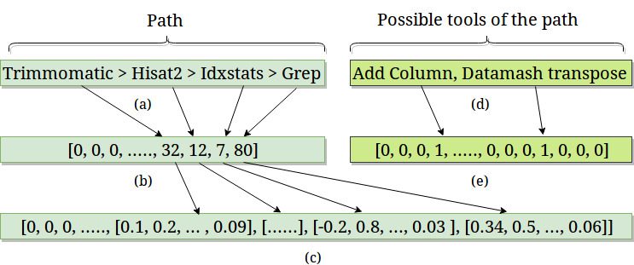
Embedding and label vectors
Dimensions:
Embedding - 512
Label vector - 1,800
Tool sequence - 25
Embedding layer: https://keras.io/layers/embeddings/

Slide 40
Network configuration
Cross-entropy loss
Root mean square propagation (rmsprop) optimiser
80% training paths, 20% test paths
20% of training paths as validation paths
1 Embedding layer, 2 hidden layers and 1 output layer
Cross-entropy: http://www.cse.unsw.edu.au/~billw/cs9444/crossentropy.html
RMSProp: https://www.cs.toronto.edu/~tijmen/csc321/slides/lecture_slides_lec6.pdf

Slide 41
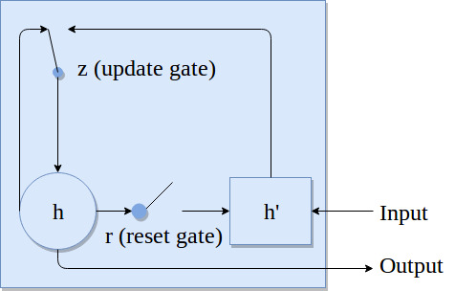



Recurrent neural network
RNN: https://arxiv.org/pdf/1412.3555.pdf

Slide 42
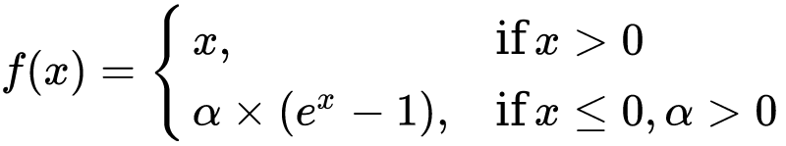
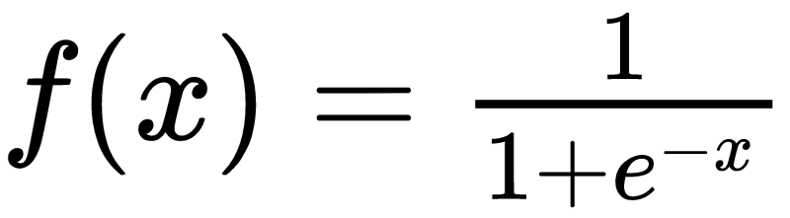
Recurrent neural network
One embedding layer, two hidden layer and one output layer
Recurrent layer activation - exponential linear unit
Output activation is sigmoid
Exponential linear units: https://arxiv.org/pdf/1511.07289.pdf

Slide 43

Recurrent neural network
Optimiser - Root mean square propagation (rmsprop)
Binary cross-entropy loss
RMSProp: https://arxiv.org/pdf/1609.04747.pdf
Binary cross-entropy: https://www.tensorflow.org/api_docs/python/tf/keras/losses/binary_crossentropy

Slide 44
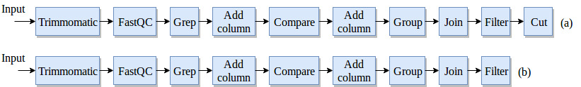
Workflow preprocessing
No decomposition
Last tool is a label

Slide 45
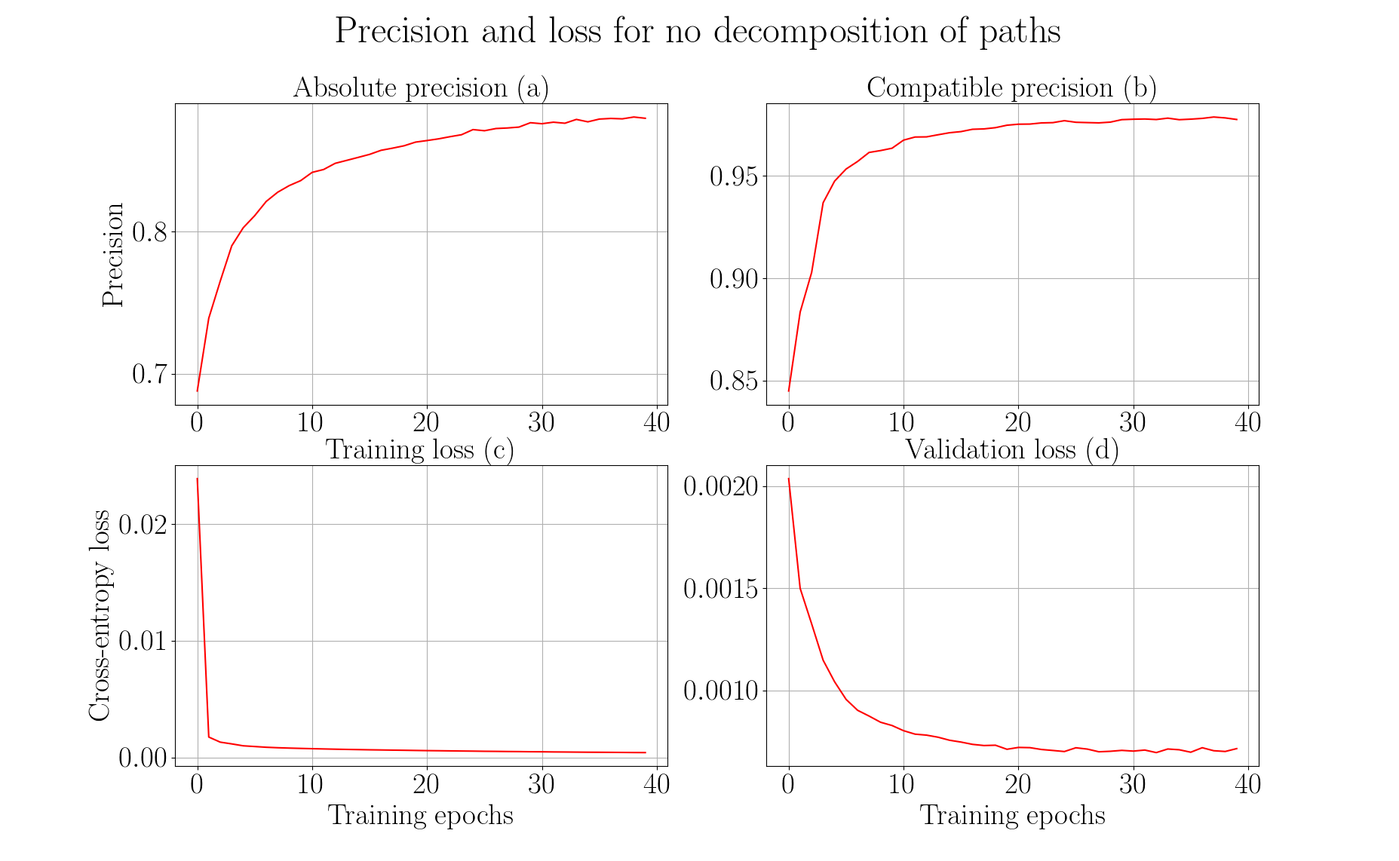

Slide 46
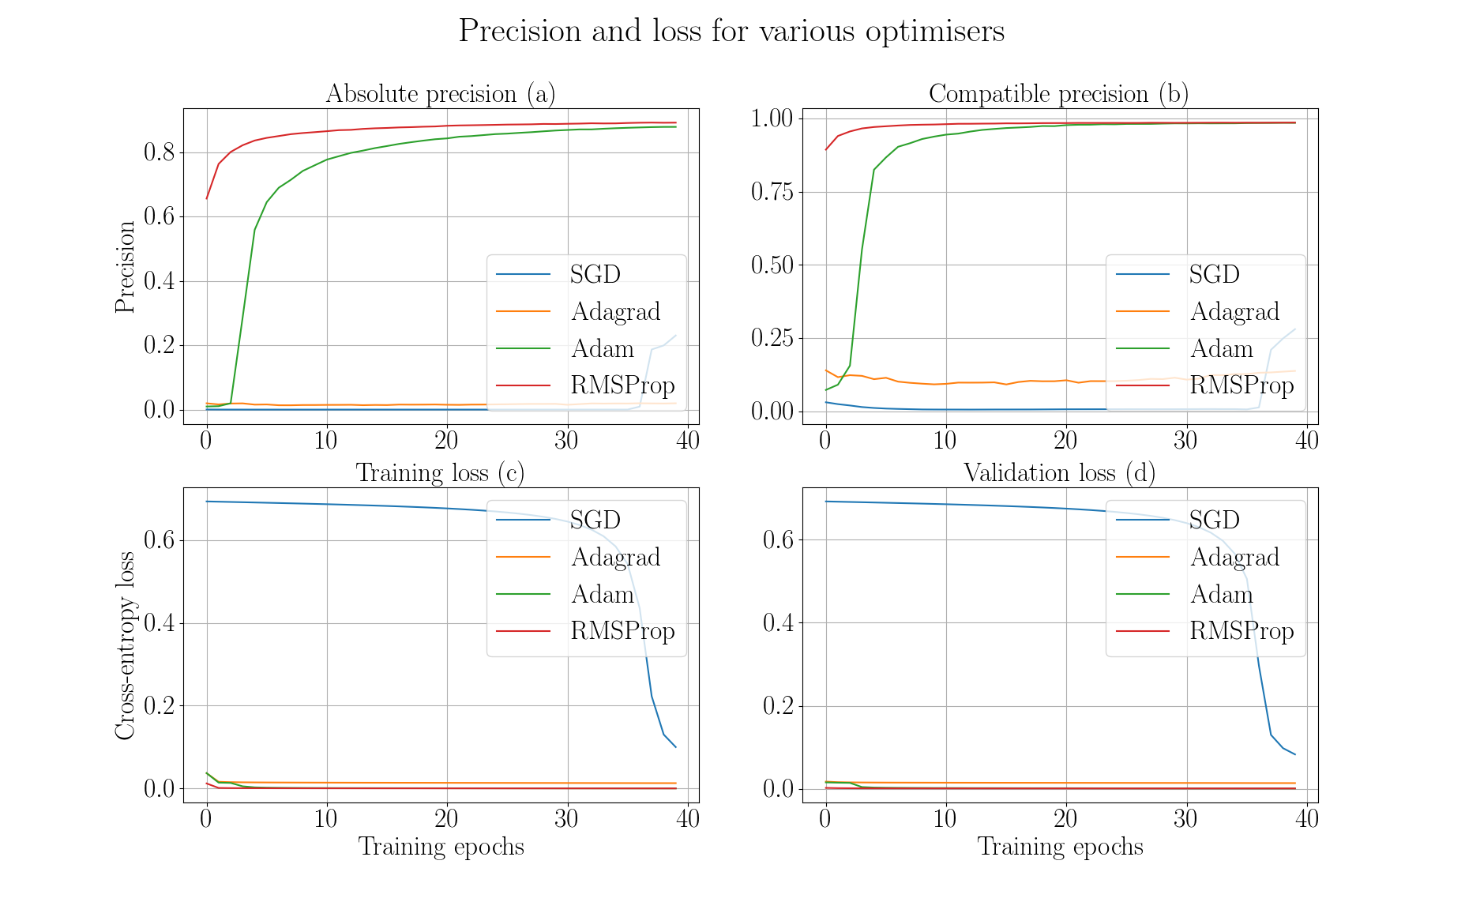

Slide 47
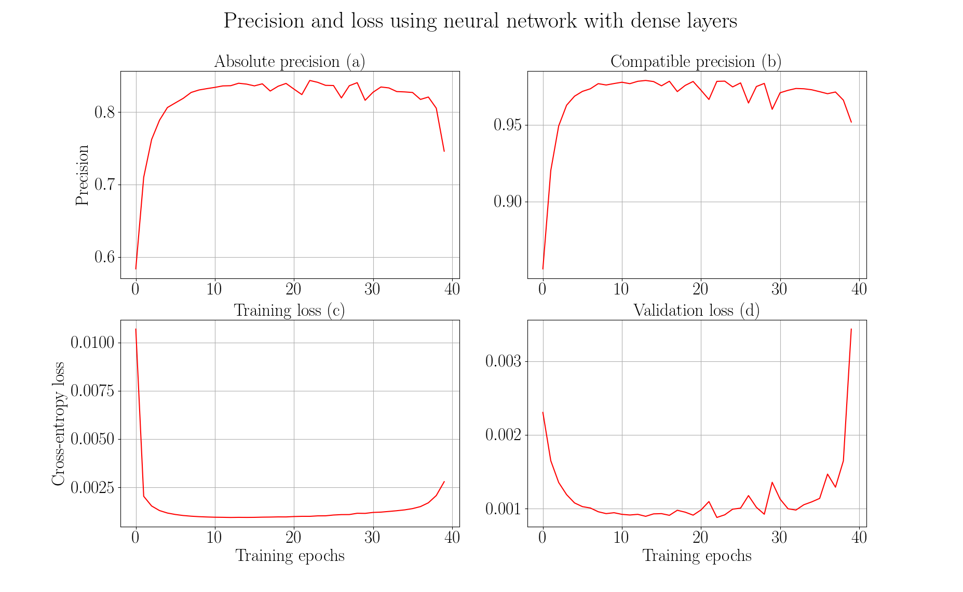

Slide 48
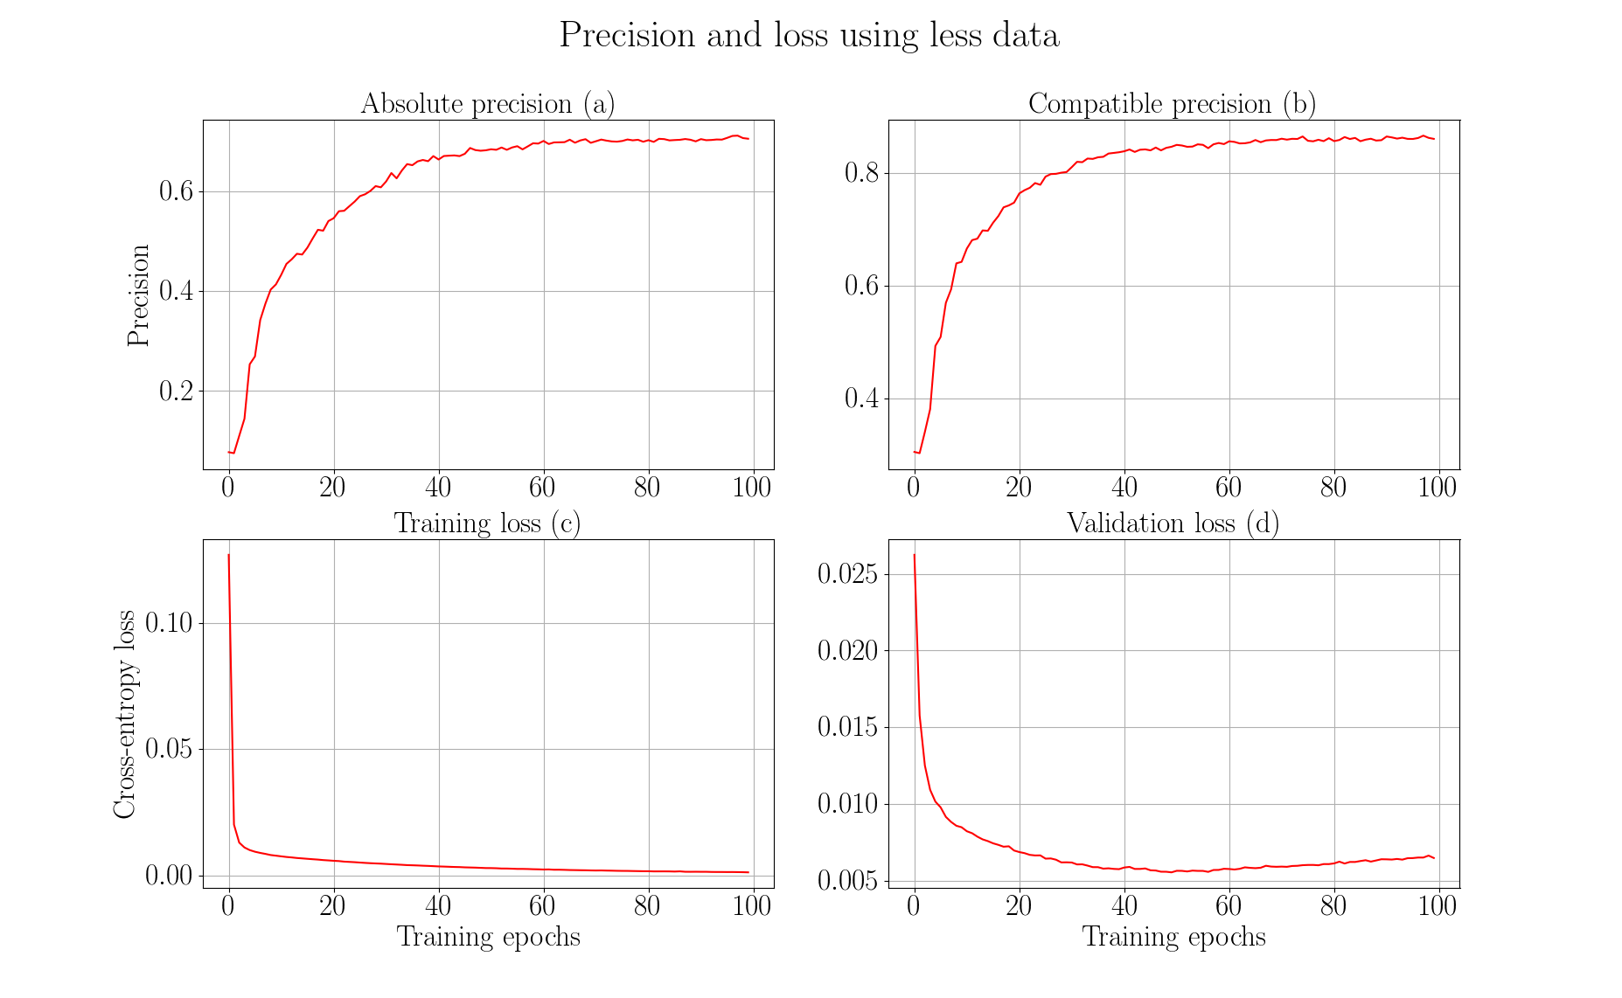

Slide 49
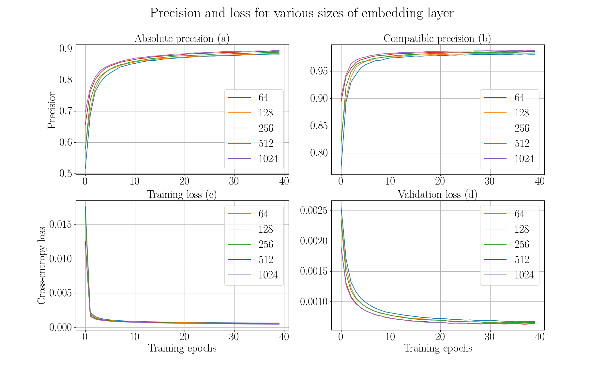

Slide 50
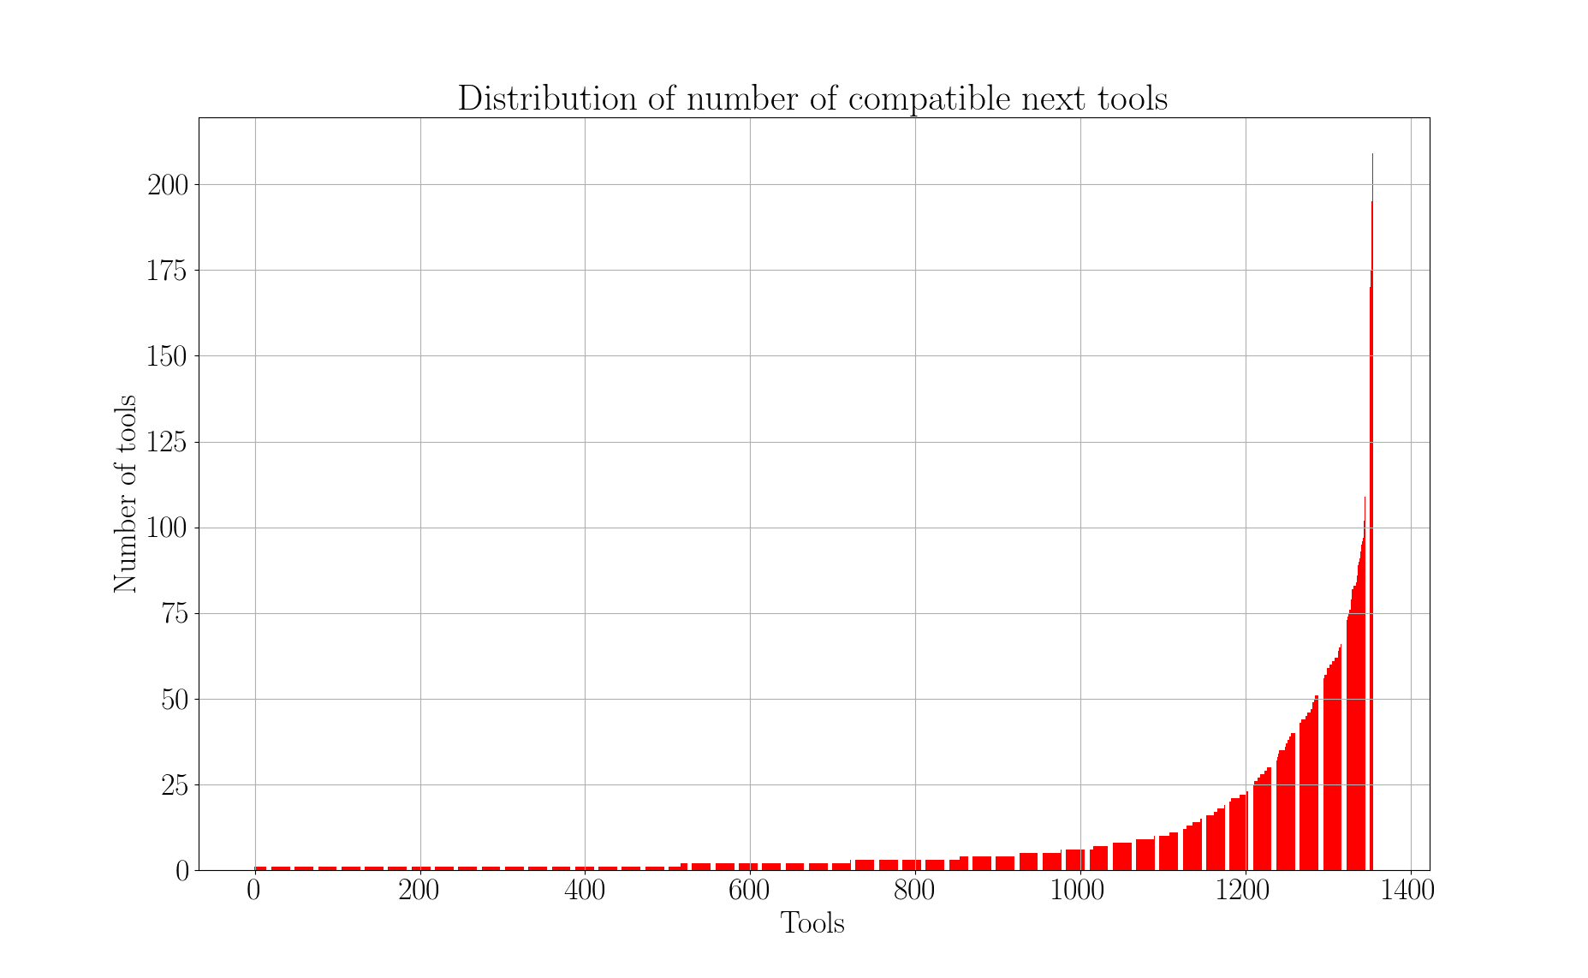

Slide 51
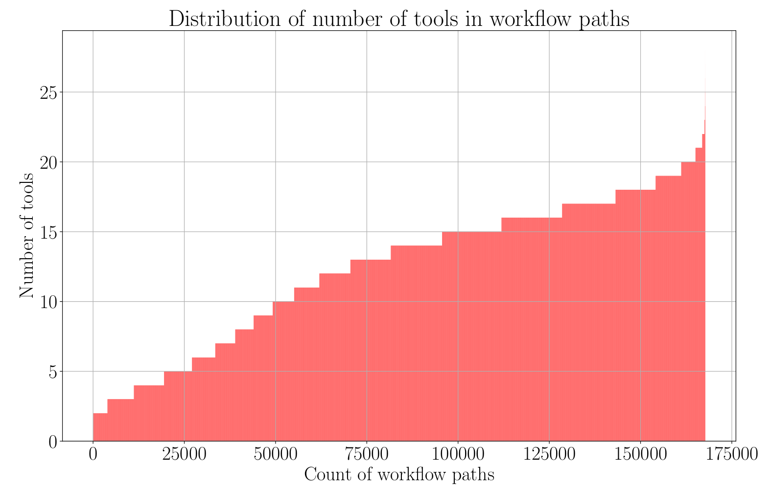

Slide 52
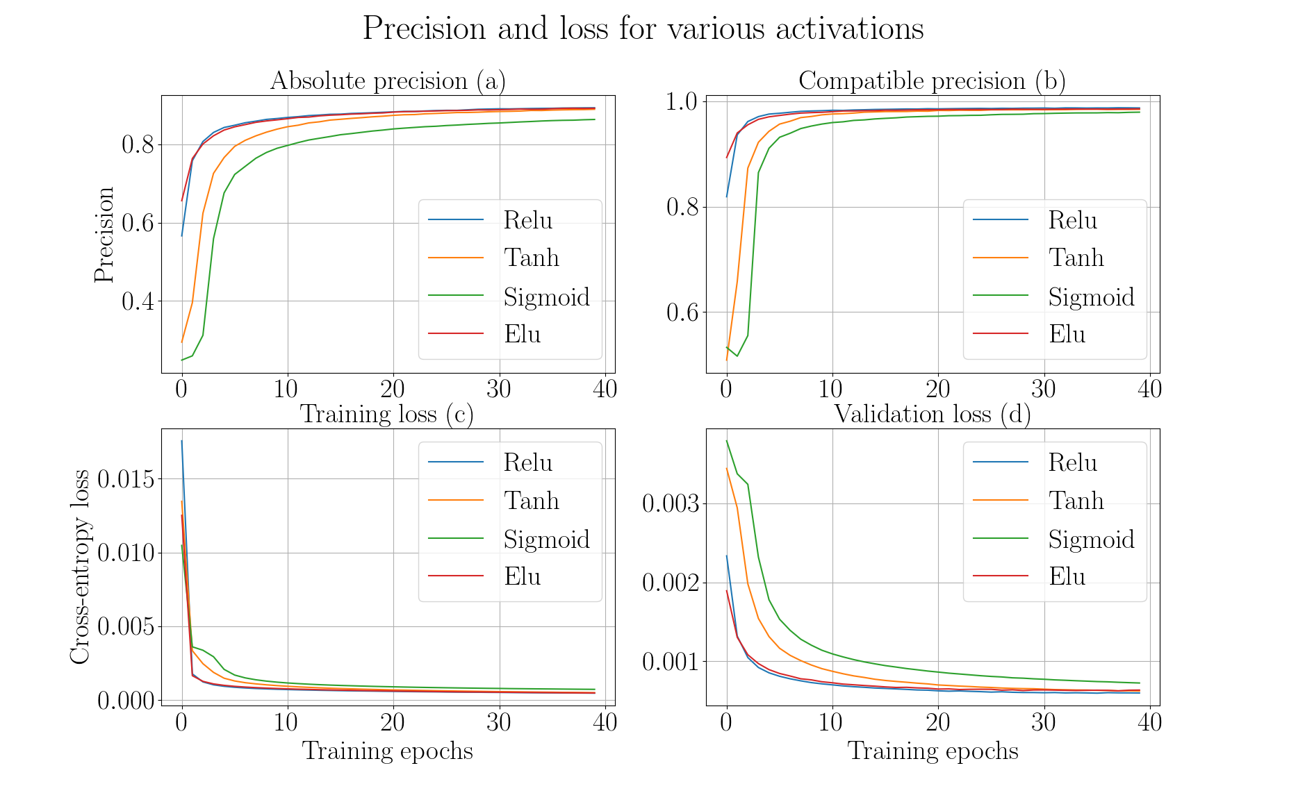

Slide 53
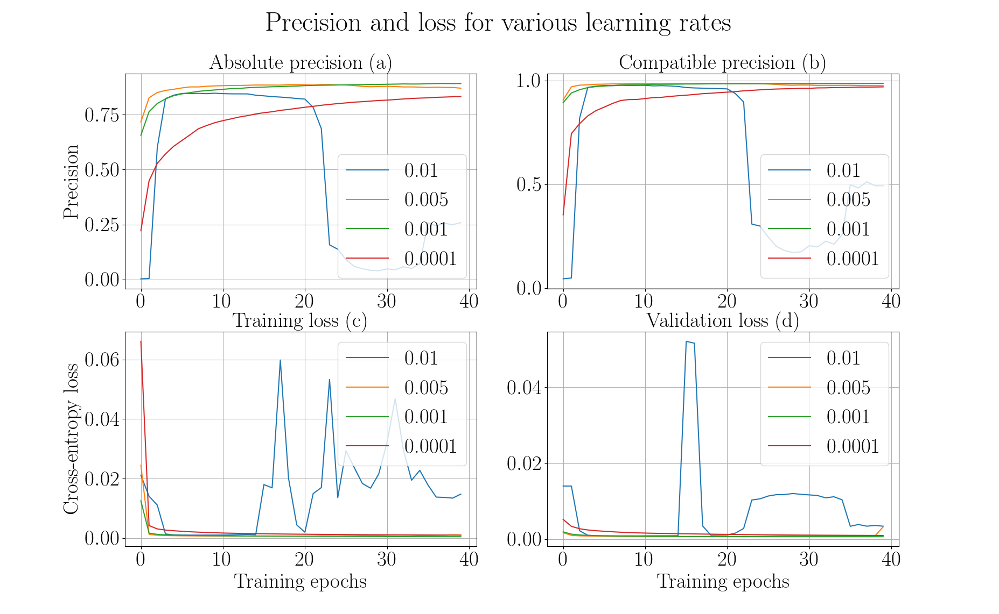

Slide 54
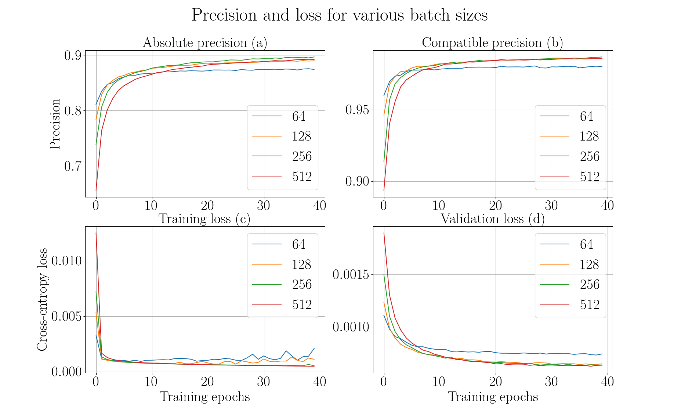

Slide 55
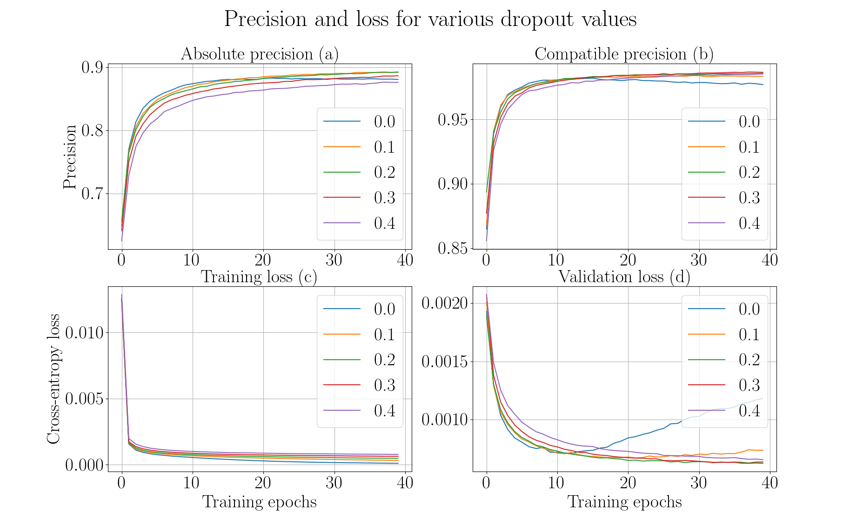

Slide 56


Slide 57


Slide 58


Slide 59

Higher order dependency
Not dependent only on immediate parent
Dependent on all previous tools
Higher order dependency: https://arxiv.org/pdf/1506.06268.pdf
https://arxiv.org/pdf/1508.03113.pdf

Slide 60
Bayesian network
Explain workflows
Predict missing nodes
Compute joint and conditional probabilities
High computational cost with large number of nodes
Prediction by probabilistic network is a hard problem
https://www.microsoft.com/en-us/research/uploads/prod/2004/01/Large-Sample-Learning-of-Bayesian-Networks-is-NP-Hard.pdf
https://www.sciencedirect.com/science/article/pii/000437029090060D

Slide 61
Hidden markov models
Transition and prior probabilities
Transition matrix is large
Current state depends only on previous state (first-order)
Higher number of parameters
Higher order markov models
https://arxiv.org/pdf/q-bio/0505002.pdf
https://pdfs.semanticscholar.org/8463/dfee2b46fa813069029149e8e80cec95659f.pdf
http://mlg.eng.cam.ac.uk/zoubin/papers/ijprai.pdf

Slide 62


